Slide 1
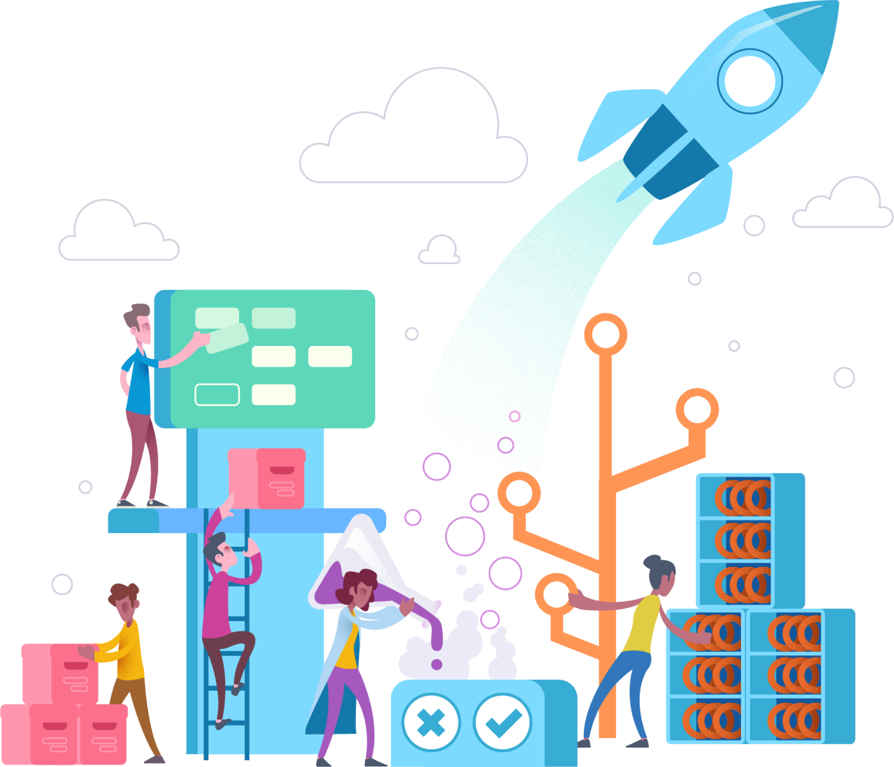
Microservices in Azure

Slide 2

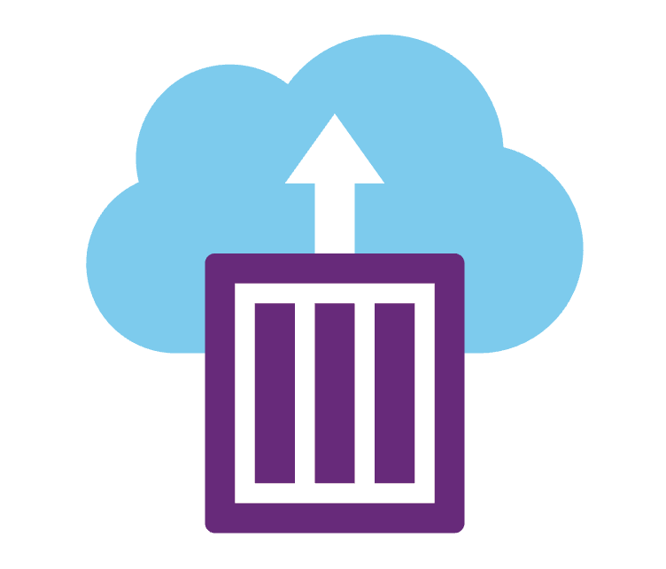
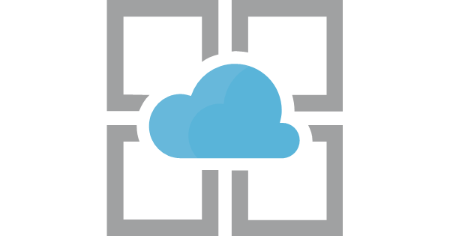

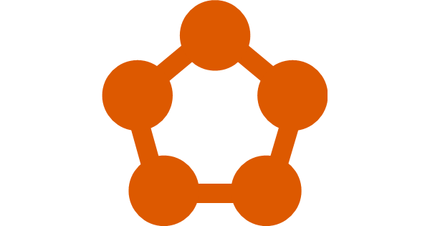
Microsoft Azure compute offerings
Azure Kubernetes Service
Container Instances
App Services
Functions
Service Fabric
Notes:
There are more options for Compute in Azure, and it is possible to use almost anything (Bare metal, stand alone VMs, etc…) to host Microservices. But the intent is to highlight the preferred options that are popular.

Slide 3
Azure Kubernetes Service (AKS)
Fully managed Kubernetes orchestration service
Auto patching, auto scaling, auto updates
Use the full Kubernetes ecosystem (100% upstream)
Deeply integrated with Azure Dev Tools and services
Notes:
Currently, Microservices architectures are most widely implemented as containers
Kubernetes is the most popular container orchestrator.
Ask crowd if they know what containers are.
Explain to them very simply:
Container is a well defined box that your application runs in, it can be deployed in a container engine such as docker, container engine runs in an OS (VM or physical).
Kubernetes is nothing more than a container orchestrator, handles running, scaling, networking load balancing and routing.

Slide 4
Azure Kubernetes Service (AKS)
A fully managed Kubernetes cluster
Managed control pane
Automated upgrades, patches
Easy cluster scaling
Self-healing
Cost savings
Managed
Application architect
Applications
Operations
Kubernetes
Infrastructure architect
Docker
Azure infrastructure services

Slide 5
From infrastructure to innovation
Managed Kubernetes empowers you to do more
Focus on your containers and code, not the plumbing of them.
Responsibilities | DIY with Kubernetes | Managed Kubernetes on Azure
Containerization
Application iteration, debugging
CI/CD
Cluster hosting
Cluster upgrade
Patching
Scaling
Monitoring and logging
Customer
Microsoft
Notes:
With the deep integration of our toolset with AKS, we share in responsibility not just to manage your Kubernetes cluster but also building for and deploying to it.

Slide 6
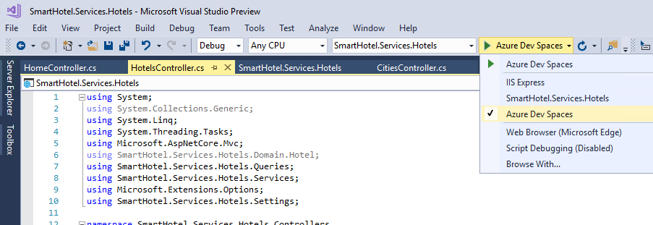
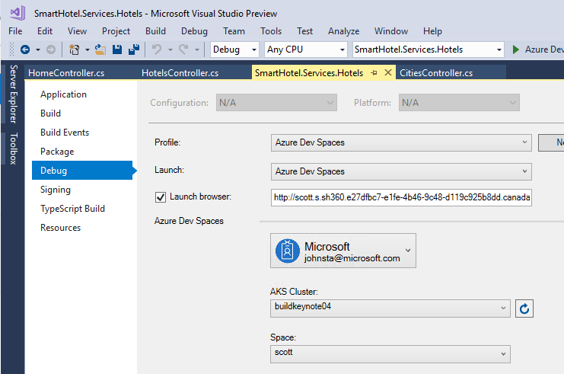
Azure Dev Spaces
Rapid, iterative Kubernetes development for teams.
Develop with Visual Studio, Visual Studio Code, or the command line. Use Windows, Mac, or Linux.
Scaffold Kubernetes and Docker configuration-as-code assets from development through to production.
Notes:
Rapid, iterative Kubernetes development for teams.
* Rapidly iterate and debug code directly in Kubernetes
* Test code end-to-end without replicating or simulating dependencies
* Quickly create a Kubernetes environment with minimal dev machine setup
Share a Kubernetes development environment for team collaboration
Develop with Visual Studio, Visual Studio Code, or the command line. Use Windows, Mac, or Linux.
Scaffold Kubernetes and Docker configuration-as-code assets from development through to production.
* Access Kubernetes instance directly and leverage the breadth of open-source tools such as kubectl and helm.

Slide 7
Azure Container Instances (ACI)
Deploy containers with a single command
Launch container instances in seconds
Cost effective per second billing
Virtual Kubelet to integrate with Kubernetes

Slide 8
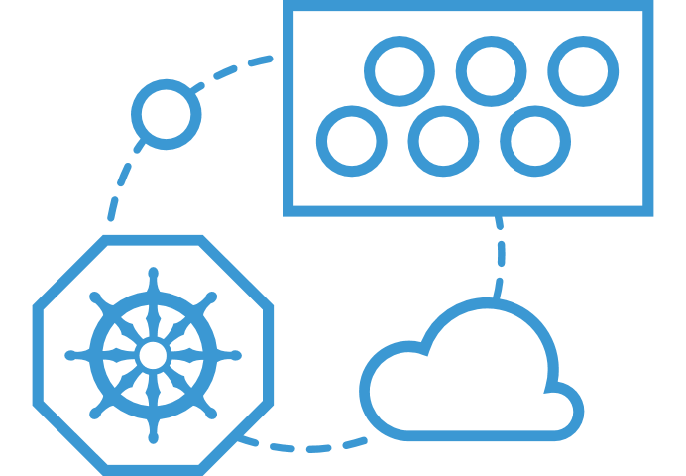
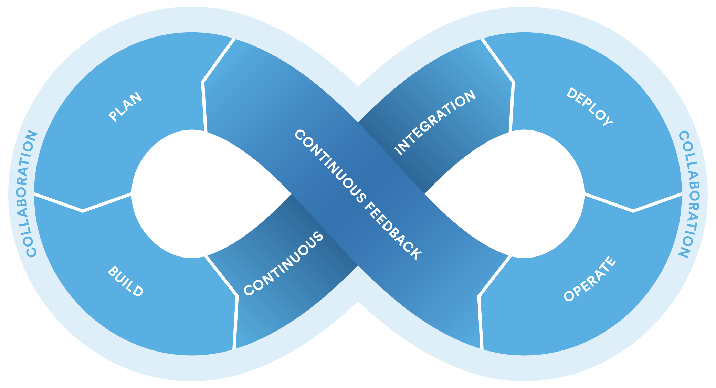
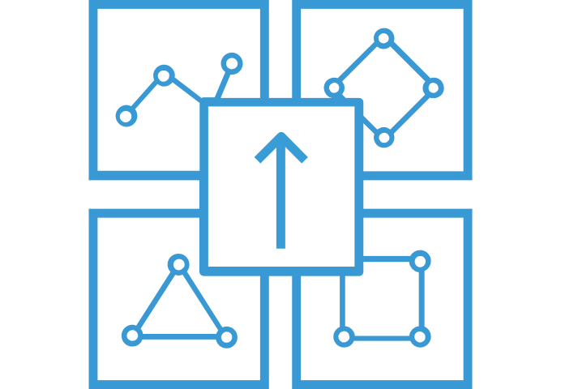
What can you build with ACI
Azure Kubernetes Service (AKS) can use the Virtual Kubelet to provision pods inside ACI that start in seconds. Then ACI provides fast, isolated compute to meet traffic that comes in spikes, without the need to manage servers.
Using ACI as a part of CI/CD Pipelines to host Containers. Lightweight fast approach to run Containers that charge by the second only.
Use Azure Container Instances for data processing where source data is ingested, processed, and placed in a durable store such as Azure Blob storage. Achieve significant cost savings through per-second billing.
Elastic bursting with AKS
Dev/Test Workloads
Data processing jobs
Notes:
ACI is a underlying hosting PaaS offering for Containers. For Microservices, it’s the underlying technology that makes hosting easier. The above are some example of what you can do with it. Highlight Bursting with AKS and Dev/Test Workloads

Slide 9
Nodeless Kubernetes (AKS + ACI)
VM
VM
Pod
Waste
Pod
Pod
Pod
Waste
Pod
Pod
Pod
Pod
Azure Container Instances (ACI)
Pod
Pod
Pod
Pod
Pod
Application architect
Kubernetes control pane
ACI Connector
Pod
Pod
Pod
Pod
Pod
Pod
Pod
Pod
Pod
Pod
Pod
Pod
Pod
Pod
Pod
Deployment/ tasks
Pod
Pod
Pod
Pod
Pod
Infrastructure architect
Pod
Waste
Pod
Pod
Pod
Waste
Pod
Pod
Pod
Pod
VM
VM
Notes:
Talk about VM nodes being too coarse grained and can be expensive in a sparsely populated cluster.
ACI’s can fill the gap and scale as needed.

Slide 10
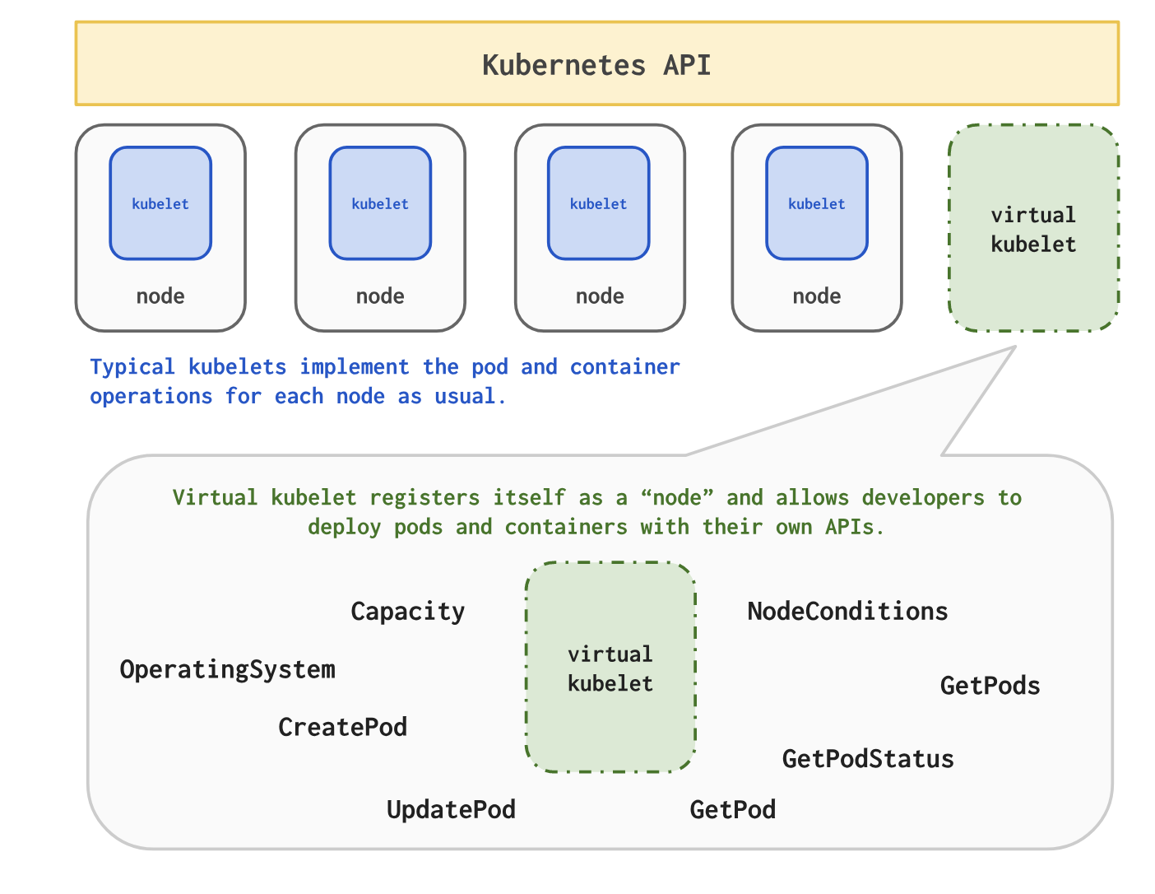
Virtual Kubelet
Notes:
Only point out here that the virtual kubelet fakes out K8S and appears as a node. When pod commands are sent, the virtual kubelet implements with ACI.

Slide 11
Azure Functions
On-demand serverless code
Develop, debug, deploy in Visual Studio & Visual Studio for Mac
CI/CD support in Azure DevOps and Github

Slide 12

Trigger object
Your code
Input object
Input Binding
Output object
Trigger
Output Binding
Triggers activate functions
Are a special kind of input binding
Examples include Http, Timer, Blob, Queue, EventGrid, Event Hub
Bindings enable ease of integration
Can be configured as input or output
Notes:
There is a lot of code you can save thanks to the Functions programming model based on triggers and bindings, as this code to connect to different services (either for trigger data and input/output operations) is done by the platform, improving your development time as you don’t lose a minute on connections code that tend to be reused a lot of times.
See the full list of services with Triggers and bindings – https://docs.microsoft.com/en-us/azure/azure-functions/functions-triggers-bindings

Slide 13
What are Azure Functions?
Open Source Project
https://github.com/Azure/Azure-Functions
Programming Model
Function as the unit of work
Functions are executed; they start and finish
Functions have triggers
Functions can have inputs and outputs (bindings)
Supported Languages
C#, F#, nodejs/Javascript, Java (Preview), Python (Preview)
Supported Triggers
Http, Service Bus, Event Grid (thru Http Subscription), Blob Events
Tooling Options
Portal, Visual Studio, VS Code, CLI, Maven (Java)
Notes:
By nature Azure Functions are simple, single unit of work deployments of code.
Bindings and Triggers are a great because they remove most of the concerns from a given service about Ingress/Egress.
There is support for multiple languages and for multiple tools, with several DevOps options.
Functions are the ultimate expression of microservices, small and fast with a well-defined interface and no dependencies.

Slide 14


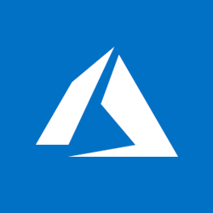
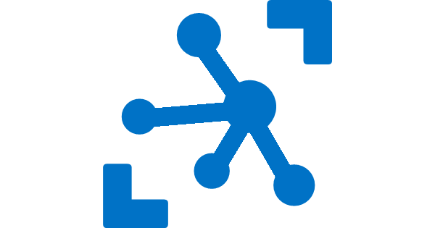
Ways to Run Azure Functions
Consumption
Serverless
App Service Plan
Free, Basic, Standard, Premium
App Service Environment
Network Isolation
Azure Stack
On Premises
Azure Functions Runtime (preview)
Functions on your Server
Azure IoT Edge (preview)
On Devices
Pay only for what you use! Metering is per execution and per GB Second.
All the advantages of Functions with the SLA and ‘always on’ features of an App Service Plan.
Your own dedicated cloud environment with network isolation for apps, higher scale, and the ability to connect securely to local vNets.
Leverage cloud innovations in on-premises infrastructure. Azure Stack brings the power of Azure to your own data centers.
Run on IoT Devices by deploying custom modules.
Run your Azure Functions on your local server (without the rest of Azure)

Slide 15
Azure App Service
Enterprise Grade Apps
Fully managed platform
High productivity development

Slide 16
Azure App Service
Quickly build, deploy and scale powerful cloud applications without worrying about infrastructure
High productivity
.NET, Node, Java, Docker, PHP, Ruby, Python
Staging & deployment
Testing in production
App gallery marketplace
Fully managed
Auto scale & load balancing
High availability w/ auto patching
Reduced operations costs
Backup & recovery
Enterprise grade
Global data center footprint
Hybrid support
AAD integration
Secure & compliance
Notes:
App Service is a managed PaaS service that lets developers focus on the unique aspects of their app, instead of spending cycles on patching and boilerplate functionality.
Rapidly create and deploy web, mobile and API apps that scale with your business, on any platform
Host individual or multi-container solutions
Free your developers from management of infrastructure
Multiple deployment slots for easy blue-green testing, A/B testing and simple rollbacks. Ultimately, you have much more control over how you do your staging.
Scale vertically and horizontally without downtime with integrated load balancer and in-memory caching – these things are baked into the platform
From a Microservices perspective, it’s a great way to host the public front ends (when using something like Functions for the services).

Slide 17

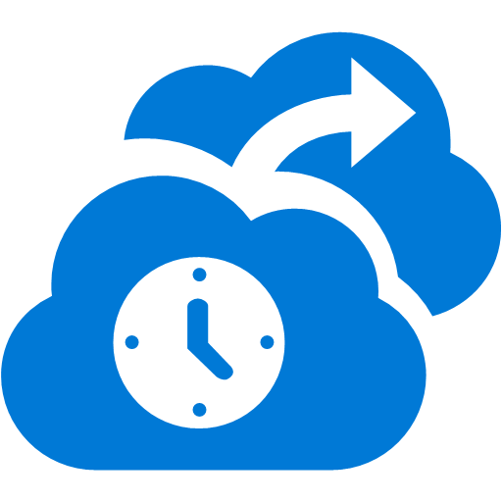

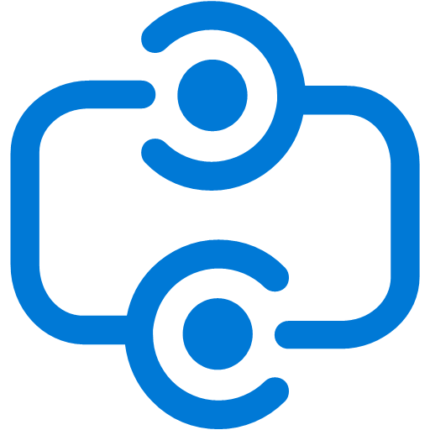




Differentiators of App Service
$
Cut costs 60–90% by moving Apps to Azure; Pay only for what you use and never worry about capacity planning
$
Deploy and test in production at any time with no performance or availability degradation using Site Slots
Global reach and presence with 40 Azure regions. Leverage traffic manager and CDN for faster response times for global users
Continuous deployment through source code repository integration with Visual Studio Online, Git, GitHub and more
Business continuity capabilities out of the box with an Azure App Service solution using site cloning and failover
SLA
99.95% uptime SLA - financially-backed by Microsoft
Quickly provision and scale capacity; Focus on your application, while Azure takes care of the underlying infrastructure
Leverage Hybrid Connections and Virtual Network to connect Azure App Service with resources on your corporate network
Develop with a choice of popular frameworks and technologies, including .NET, Java, PHP, Python, Node.js, Ruby, and even Classic ASP
Leverage endpoint monitoring, dashboard views, automated alerts and site diagnostics, all of which are provided at no extra charge

Slide 18
Azure Service Fabric
Always-on, scalable, distribute apps
Run anything: Choice of languages and programming models
Run anywhere: On premises or any cloud on Windows or Linux

Slide 19
Azure Service Fabric: Microservices platform
Build, deploy, and operate applications as microservices, using any OS, at any scale, on any cloud
Programming Models
Dev & Ops Tooling
Orchestration
Lifecycle Management
Health &
Monitoring
Always On Availability
Auto
Scaling
Dev machine
Azure
On-premises infrastructure
Other clouds
Notes:
Read the blurb
Explain that all Microsoft’s services run on it
And it can run anywhere.

Slide 20
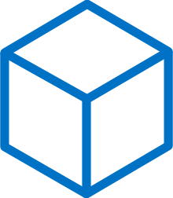
Build: data-aware microservices
Programming Models
Dev & Ops Tooling
Orchestration
Lifecycle Management
Health &
Monitoring
Always On Availability
Auto
Scaling
Lifecycle Management
Always On Availability
Orchestration
Programming
Models
Health &
Monitoring
Dev & Ops
Tooling
Auto
Scaling
</>
Reliable Actors
Reliable Services
Guest Executables
Containers
.NET, or Java
Maximize uptime and scalability with stateful and stateless Actors
Manage state reliability without a database, lowering latency. Use stateless services to write data to external data stores
Run any existing code
Orchestrate your Windows Server or Linux containers reliably at scale
Best platform for .NET and ASP.NET core with Visual Studio 2017 and Java using Eclipse and Jenkins
Notes:
Talk about actors and services as native
Explain languages: .NET and Java
Also support for more mundane methods: Executables and Containers
Guest Executables/Containers
Any exe in any language
Packaged as application or container
Reliable Services
Stateless & stateful
Independent lifecycles
Access to reliable collections with transactions
Native to service fabric
Reliable Actors
Simplified programming model
Isolated compute and state
Single threaded, turn based concurrency

Slide 21
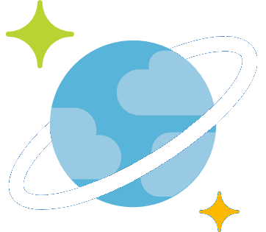
Data Options

Slide 22

Microsoft Azure database services
Leverage a single programming surface for a consistent experience
Azure SQL Database
Azure Cosmos DB
Intelligent relational cloud database service
Globally distributed, multi-model database service
My
Azure Database for MySQL
Azure Database for PostgreSQL
Azure Database for MariaDB
Managed MySQL database service
Managed PostgreSQL database service
Managed MariaDB database service
Notes:
Objective: Composition and integration of Microsoft Azure Data Services across relational and non-relational data storage options
Problem: As developers, we look to relational databases as a default for all our data storage needs while in many cases, non-relational data stores are likely more suited to the job.
Talking Points:
The table above gives an overview of the various data storage options that are available with Azure.
As a developer, most of the time we look into relational databases and what they have to offer. What we often overlook is non-relational databases, which can handle certain tasks more efficiently when compared to the relational counterpart. However, certain operations are definitely suited better to relational databases that offer a query-rich environment.
Azure Tables stores a single serialized object for each key value, which is great for storing large volumes of data. In addition, Azure Blob is a key/value database where a key corresponds to files or folders.
Document databases, on the other hand, are key/value databases where the values are “documents” or essentially a collection of named fields and values. Document DBs have the additional capability of better queries on non-key fields.
Platform as a service (PaaS) includes Azure SQL (relational), Azure Table (NoSQL) and Azure Blob (file storage in cloud). Infrastructure as a service (IaaS) allows you to simply spin up a VM with an OS image, and you can install the DBMS of your choice such as SQL Server.
It is important to understand the advantages of using an IaaS option over the PaaS and vice-versa. Yes, IaaS does give you a lot of options and the flexibility to manage your system as per your need, but then you have to configure and manage your VMs end to end. In PaaS, you do not have to do that. The service provider (Microsoft in this case) manages the hardware and software for you, which includes setup, updates, software patches, scaling up, licenses, and every other aspect of administration. This essentially abstracts the administration for the end user, who just consumes the database service provided.

Slide 23
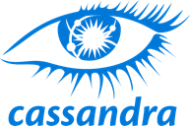


Azure Cosmos DB
A globally distributed, massively scalable, multi-model database service
SQL
MongoDB
Table API
Column-family
Document
Key-value
Graph
Guaranteed low latency at the 99th percentile
Elastic scale out
of storage & throughput
Five well-defined consistency models
Turnkey global distribution
Comprehensive SLAs
Notes:
Highlight mulit-master with Server <10 ms read and <15 ms write requests at the 99th percentile from the region nearest to users, while delivering data globally.

Slide 24
FIVE WELL-DEFINED CONSISTENCY MODELS
CHOOSE THE BEST CONSISTENCY MODEL FOR YOUR APP
Offers five consistency models
Provides control over performance-consistency tradeoffs, backed by comprehensive SLAs.
An intuitive programming model offering low latency and high availability for your planet-scale app.
Strong
Bounded-staleness
Session
Consistent prefix
Eventual
Notes:
Tunable Consistency -> Single digit latency
Strong
What everyone understands. A read sees the effects of all previously completed writes. A client never sees uncommitted or partial writes.
Highest consistency, lowest performance.
Costs almost twice as much as session, consistent prefix, or eventual consistency.
highest consistency, highest latency, lowest throughput, effectively lowest availability (scaling adds latency)
Bounded Staleness
Consistent Prefix. Reads lag behind writes by k prefixes (operations) or t interval
minimum of 10 operations, minimum of 5 seconds of lag
Provides a guarantee for “how eventual” eventual is
better performance than strong consistency
Like strong, about twice the cost of session, consistent prefix, and eventual consistency
Ex. Social apps, fitness apps, shopping cart
Session
Consistent Prefix. Monotonic reads, monotonic writes, read-your-writes, write-follows-reads.
less than half as expensive as strong consistency and bounded staleness.
Think of a session as your application or connection.
Data from other sessions comes in the correct order
provides good performance and good availability at half the cost of strong consistency and bounded staleness
Consistent Prefix
Updates returned are some prefix of all the updates, with no gaps. Reads never see out of order writes.
Reads are accurate, but not guaranteed to be current.
No guarantees on how current but in many cases, delays are likely to be in seconds and not minutes
Good performance and excellent availability because the various nodes can take whatever time is needed to synchronize and agree on the current model
Examples: social media (comments, likes), apps with updates like scores
Eventual Consistency
Out of order reads.
Examples: non-ordered updates like reviews and ratings, aggregated status
High availability, low latency, highest throughput

Slide 25

Messaging Options

Slide 26

Service Bus
Decoupling and providing durability are primary drivers for using Service Bus
Queue / Topic
Front End / UX
Back End / Processing

Slide 27
Features of Service Bus
Scheduled delivery
Poison message handling
ForwardTo
Defer
Sessions
Batching
Ordering
Auto-delete on idle
OnMessage
Duplicate detection
Filters
Actions
Transactions

Slide 28
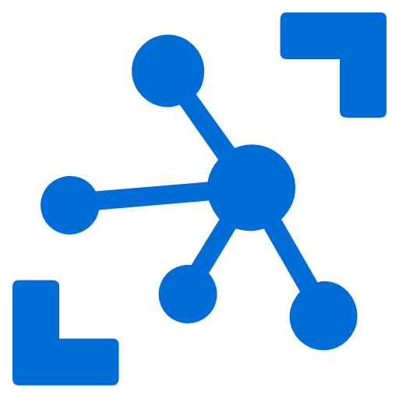




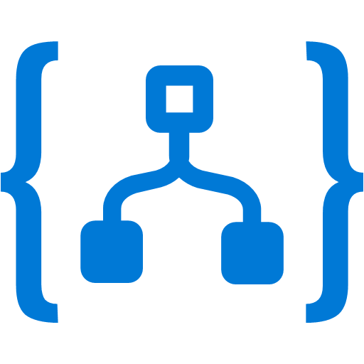
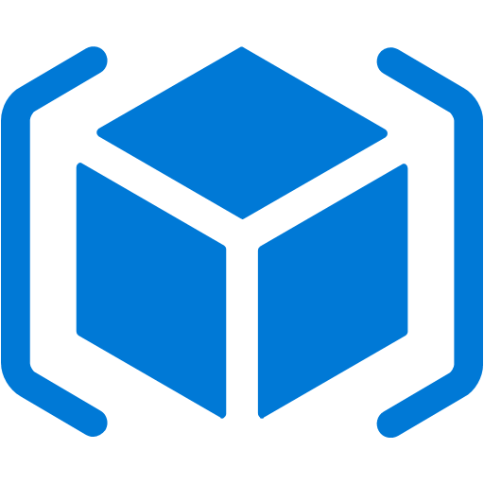

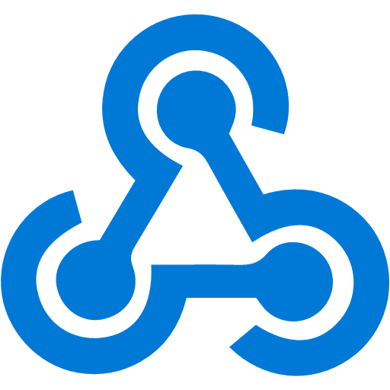

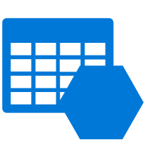
Event Grid
Event publishers
IoT Hub
Event handlers
Blob Storage
Azure Functions
Eliminate polling—and the associated cost and latency
Build reliable apps and services through reactive programming
Enable richer scenarios by connecting multiple event sources and destinations
Support for open CloudEvent standard
Azure Subscriptions
Logic Apps
Resource Groups
Azure Automation
Event Hubs
WebHooks
Custom Topics
Event Hubs
Storage (GPv2)
Notes:
Contrast to Service Bus:
http support
Push model
Event vs. messages, no complex or large message support
Now, I would like to describe the capabilities of our core serverless services, in a little more detail, this time starting with Azure Event Grid.
We already talked about how important events are.
This service allows you to manage all events in a single place
Notice that multiple Azure services today publish their events into Event Grid and these events can be routed to multiple destination. We have Functions, Logic Apps and even other services like Automation and generic webhooks.
You can also create your own customer events
The rich set of publishers and consumers opens up many interesting scenarios for you to construct already. And the list of services that will publish their events to Event Grid will continue to grow over time.

Slide 29
Event Grid delivers at massive scale
Sub-second end-to-end latency in the 99th percentile
10,000,000 events per second per region
24-hour retry with exponential back off for events not delivered
Near real-time
Massive scale-out
High reliability
Notes:
In terms of performance and scale, Event Grid makes some strong guarantees.
Sub-second e2e latency in the 99th percentile, which is as close to real-time delivery as it gets
An ability to route about 10 million events per second, so massive scale
And, an intelligent logic to retry the event delivery if the first time doesn’t succeed
All of these make Event Grid a very powerful event backbone for your serverless applications.

Slide 30
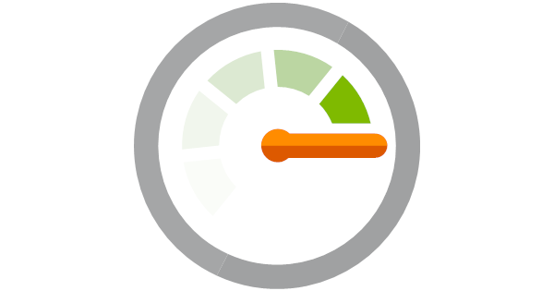
Monitoring/Diagnostics

Slide 31
Notes:
SPEAKER NOTES
Azure Monitor provides capabilities that give you an end to end monitoring tool that your engineers can rely on to debug modern day application.
For Azure resources, we have tight integrations that will provide you near real time data out of the box. You can then do different things with this data. For most customers, they will rely on our end to end insights to debug and fix issues.
Application insights for debugging performance, failure and transactions for their apps.
Some ops teams like to have live dashboards and visualization – you can do that too.
We have powerful log analytics with advanced querying capabilities that allows you to find issues from your operational logs.
You can create alerts – we recently launched a new alerts platform – where you can automate responses to issues. And finally you can integrate with other tools.

Slide 32
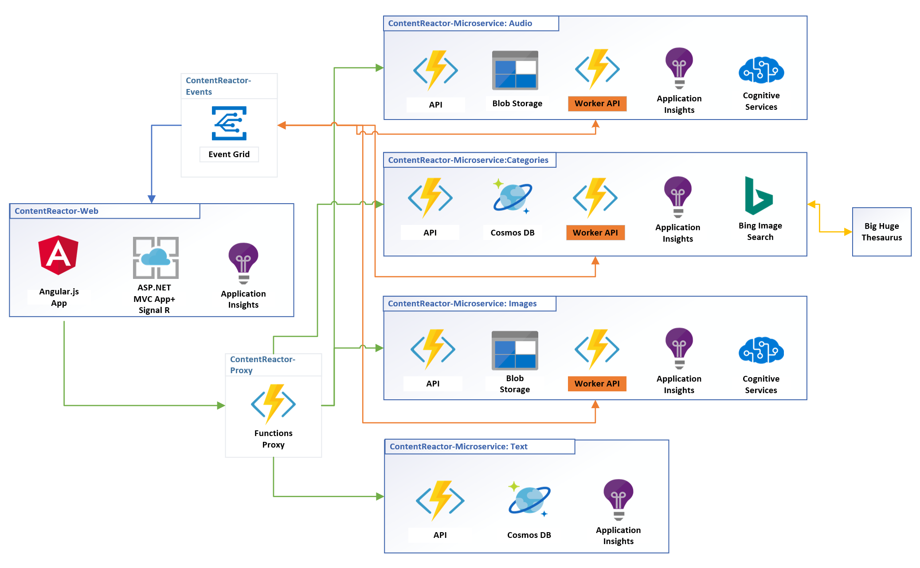
Microservices using App Services and Functions
Notes:
In this diagram, highlight that this is a well architected Microservices architecture using azure technologies.
Web app makes synchronous calls to an API proxy
Functions in individual services do the work with their own data stores.
Returned data is asynchronous coming through event grid as call backs.
Highlight that each microservice
Has its own choice of data store
Has its own APM independent of others
Can use any other services it wants

Slide 34
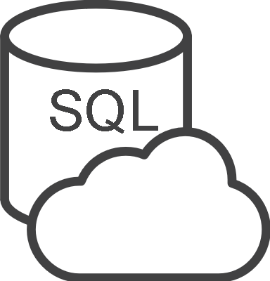




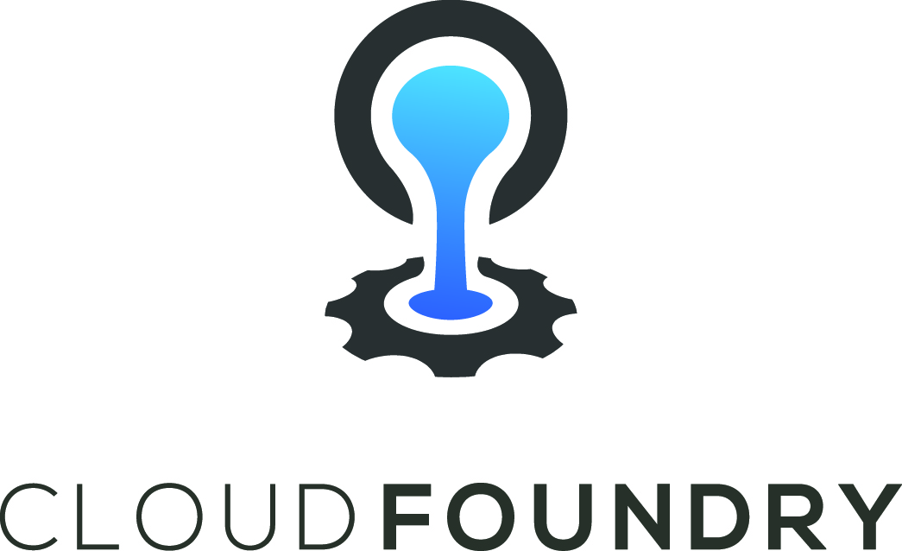
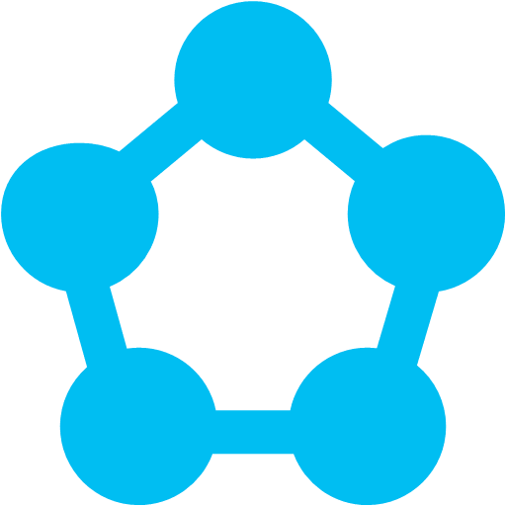
Open Service Broker for Azure
Azure SQL Database
Redis Cache
CosmosDB
And more!
Open Service Broker for Azure (OSBA)
OpenShift
Cloud Foundry
Service Fabric
Kubernetes (AKS)

Slide 35

What is Azure Functions?
Binding
Code
Binding
Inputs
Outputs
Trigger

Slide 36

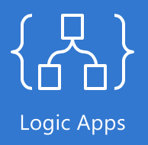


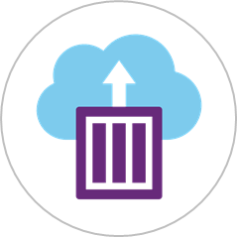






Microsoft Azure Serverless Platform
Events
Serverless Code/
Serverless Workflow
and Integration
Blob Storage
Functions
Resource Groups
Event Grid
Serverless Platforms
Azure Subscriptions
ACI
SF Mesh
Event Hubs
Other services and applications
Custom Events (anything)
Azure Automation
WebHooks (anything)
+ more

Slide 37
Enterprise grade
Get the control you want with a variety of hosting options
Azure App Service (multi-tenant)
App Service Environment
Get your Web, API, or Mobile App created in seconds in the cloud. We provide the plumbing, you provide the application code or container(s).
Run your apps in virtual network at high scale. Create an isolated environment specifically for your organization and access/manage all of the resources behind your public endpoint.
Notes:
There are several different options based on what you need
We can offer App Service to you on-prem or in the cloud: you have your choice of App Service, ASE on an isolated environment, or Azure Stack.
ASE is the premium offering that we see a lot of enterprises leaning toward: it's dedicated to you, enterprise grade, with an isolated environment. So if have any specific security requirements, ASE can satisfy those.
And we can work with you to customize what that would look like.
Dedicated Hardward and Network Isolation based on InfoSec requirements
Which of these solutions look like they would be most appropriate for your business?
Are you using any cloud services at the moment?
What are the security concerns at your business?

Slide 38

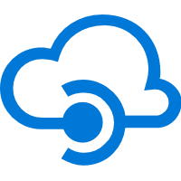
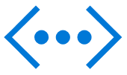
Layered security
Enterprise scale
Hybrid connectivity
Network isolation
Built-in auto scale and load balancing
Network Security Groups
App Service Environment
Run business-critical web apps in a virtual network
Application Gateway
Upgraded CPU and capacity
VPN
AAD integrated
Global data center footprint
Express routes
API security
High availability w/ auto-patching
VNET peering
Notes:
App Service Environment is our solution for our customers who want more security and the best possible performance.
With multi-tenant App Service, you may have noisy neighbors – so if they, for example, are doing load testing or getting bombarded with traffic, it could cause an increase in latency.
With ASE, that won’t happen because you have network isolation: your load balancers and network groups are dedicated just to you.
ASE also has more scaling capacity; you can have up to 200 instances, whereas the limit on an App Service multi-tenant plan is 20.
With ASE, you also have the ability to connect securely to local VNets.
Which, if any, of these benefits would be needed for your company?

Slide 39
We run it so you don’t have to…
Monitoring Service
Local Container / Stacks Cache
Persistent Site Storage
Incoming Request
Your Code
Front End Load balancers
App Container 1
App Container n
Spare instances
Runtime Database
Provisioning API Endpoint
Notes:
Needs to be reworked to be not FUGLY

Slide 40
GUARANTEED LOW LATENCY
PROVIDE USERS AROUND THE WORLD WITH FAST ACCESS TO DATA
Serve <10 ms read and <15 ms write requests at the 99th percentile from the region nearest to users, while delivering data globally.
Notes:
Single digit latency -> SLA

Slide 41
Azure SQL Database – Everything built-in
The intelligent relational cloud database service
Intelligent performance
Scales on the fly
Business continuity
Works in your environment
Advanced threat protection
Realize automatic performance improvements from continuous assessment and innovation
Change service tiers, performance levels, and storage dynamically without downtime
Easily manage and monitor business critical functions for reliable operations
Develop your app and connect to SQL Database with the tools and platforms you prefer
Build security-enhanced apps with built-in protection and industry-leading compliance
Notes:
Objective: This slide is intended to break down the features and services of Azure SQL Database.
Talking Points:
Scales on the fly - Scale performance anytime, anywhere, without app downtime
When demand for your app grows from a handful of devices and customers to millions, SQL Database is the database service that can scale along with you—on the fly and with no app downtime.
Business Continuity – Easily manages and monitor your business critical functions
Your mission critical applications are core to your business and their uptime and performance are critical to successfully deploying them to Azure. Azure SQL Database has all the critical features to ensure business continuity built in and deployed in seconds.
Learns and adapts – Learn and adapt dynamically with your app
As your app runs, Azure SQL Database continuously learns your unique app patterns, adaptively tunes your performance, and automatically improves reliability and data protection—freeing you to focus on your app.
Works with your environment - Work within your preferred development environments
Develop your app with the tools and platforms you prefer. Microsoft Azure SQL Database make it easy to connect to SQL Database with a variety of technologies enabling you to focus on developing business logic and apps using tools you are familiar with.
Protects and secures – Help protect and secure your app data
Build security-enhanced apps in the cloud with built-in data protection, high availability, and security features—without implementing custom code. With physical and operational security built in to Azure, SQL Database can help you meet the most stringent regulatory compliances.
Recover from disaster
Reduce the impact of a disaster on your business. Using azure tools for business continuity to ensure that your data is resilient from disaster. With automated backups and active geo-replication in up to four secondary readable locations you can be sure that your data is safe. Using failover groups ensures that during a outage in one location a secondary location can automatically can take over and ensure minimum outage time.

Slide 42
Monitoring & diagnostics
Host machine
CPU, Memory, Disk, Network
Containers
CPU, Memory, Disk, Network
Container events
Link container data to host data
Services
Log aggregation & analytics
Use activity or correlation id’s
Consider an agent as an operations adapter
Use a common log format (UTC)
Notes:
Let us think about the following scenario. We detect that one of our containers has a very high CPU usage. As we have learned we can spin up a container quickly, we may think just to spin up another one to add more CPU capacity. However if the current host environment is running low on CPU, we are unable to put a new container on it. In this case, we would need to add a new host VM first and then put the container on it.

Slide 43
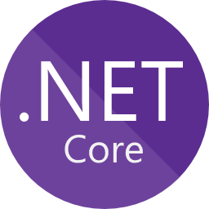


Diagnostics and Monitoring
Use your favorite APM platform to monitor apps inside containers
Containers write out stdout/stderr logs
Azure Monitor for platform events and container metrics
Service
stdout/stderr
Container
Volume
AppInsights SDK
Code
Azure Application Insights
Platform events & metrics
Azure Compute
Azure Monitor
Notes:
Deep: SF mesh was built with the intent of making Diagnostics and monitoring services easy.
Platform events (container provisioning and deployment) and container metrics will be available as a default via Azure Monitor
Events: licontainer activated, deactivated, terminated
Metrics: CPU %, Mem usage, Mem usage %, Network I/O
Application events
The common pattern of using stdout/stderr with docker containers is supported. You can access your logs via CLI as well as put them on a mounted volume so you can bring your monitoring solution sidecar (fluentd) or processes (logstash) and tail the files to get them to Log Analytics, Elasticsearch, or whatever platform you choose to aggregate your logs
.NET based applications – Application Insights. Continue to offer and build on a great integration story for SF Apps in .NET using AI for monitoring.

Slide 44
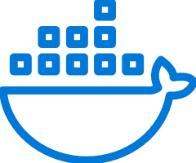

Deploy: any code on any OS
Programming Models
Dev & Ops Tooling
Orchestration
Lifecycle Management
Health &
Monitoring
Always On Availability
Auto
Scaling
Lifecycle Management
Always On Availability
Orchestration
Programming
Models
Health &
Monitoring
Dev & Ops
Tooling
Auto
Scaling
CI/CD
Docker Compose and
Container Instances
Automate
Rolling upgrades
Monitor and diagnose
Use familiar tools: Visual Studio + Team Services for .NET or Jenkins + Yeomen for Java
Deploy or remove applications using PowerShell, CLI, Visual Studio, and other APIs
Upgrade non-disruptively and roll-back in case of failures, automate with PowerShell
Generate, aggregate, and analyze events with built-in tooling and integration with Azure services such as AppInsights and OMS
Orchestrate existing container applications or deploy single containers

Slide 45

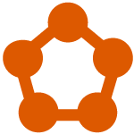
Proven platform powering core Azure and Microsoft services
SQL Database
Microsoft has deep expertise in running global services such as Cortana, Skype & Cosmos DB
Service Fabric is the foundational technology powering these services & core Azure infra
Sample scale of one of these services: 60 billion events per day with millions of databases
Around 30% of Azure’s cores run Service Fabric directly.
Service Fabric Manages Millions of Service upgrades weekly within Microsoft alone
SQL
Power BI
{ }
Cosmos DB
Dynamics
IoT Hub
Intune
Event Hub
Cortana
Skype
Designed for mission critical tier 1 workloads

